Slide 1

NBA Statistics
Data Warehouse
Group 7
Ankit Gupta
Ganesh Nagendra Prasad
Daniel Rim
Xuan Wang
Yiyang Zhuang

Slide 2
Business Questions
Below are some business questions that can be answered by the data warehouse:
How are teams performing over the years?
How are players performing over the years?
What basketball statistic of a team is a good predictor of a winning a single game?
Was the player’s salary justified?
What type of a shooter is the player?
Notes:
Recent Trends in Wins
Recent Trends in average player stats
Logistic regression
Simple performance metric vs salary
Sportvu data

Slide 3
ETL Lessons Learned / Tips / Tricks
Extract
Data from http://stats.NBA.com
http://draftexpress.com
http://basketball-reference.com
Transform
Transformation using R to convert to csv files
Load
Loading using SSIS

Slide 4
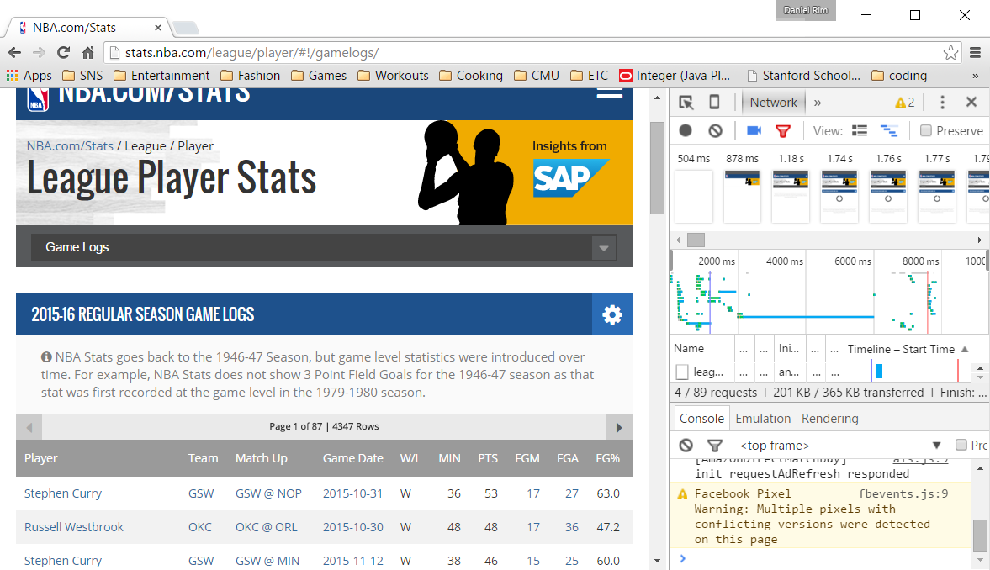
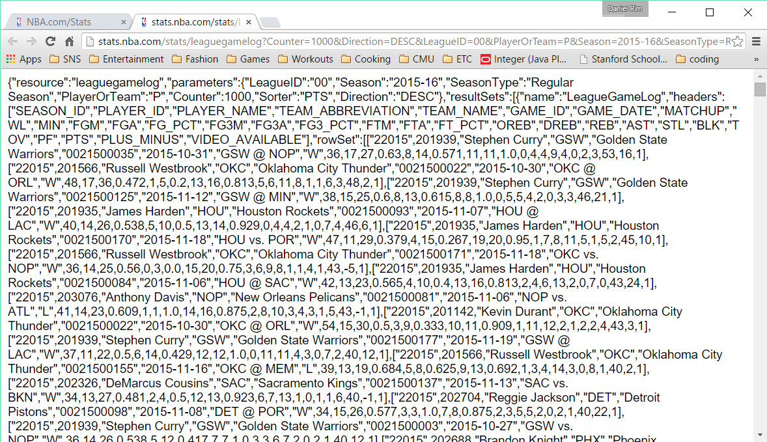
Data Source

Slide 5
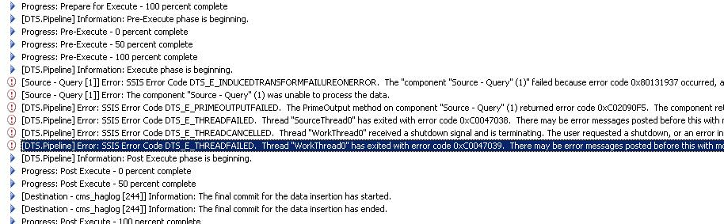
BEWARE OF THE ERRORS

Slide 6
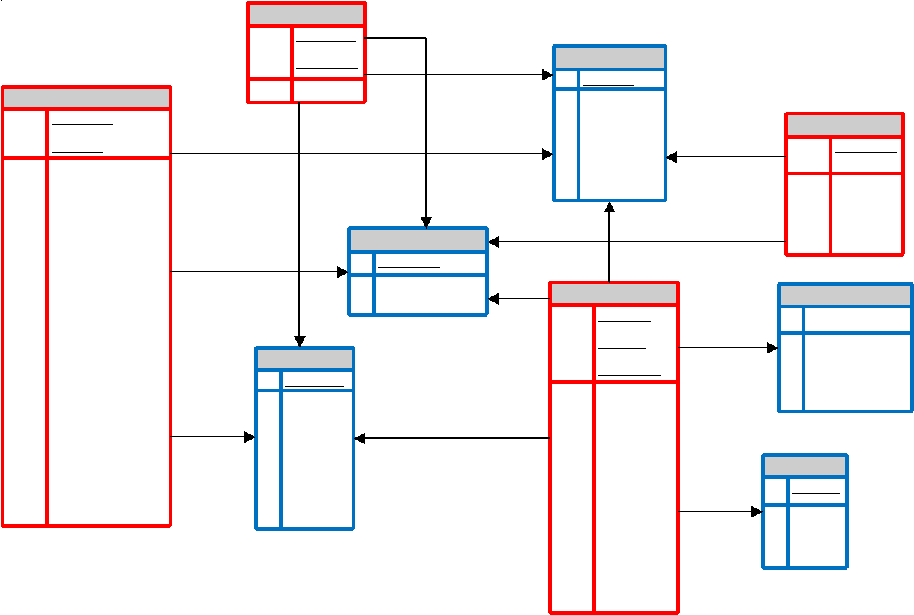
Data Warehouse Schema
RED = Fact Tables
BLUE = Dimensional Tables

Slide 7

Main Fact Table
Player Stats Fact Table:
Grain: Game Statistics per Each Player at Each Game
Tracks the game statistics of each player at each game over 20 seasons. Traditional statistics are listed in the table.
Number of Records: 461,561

Slide 8



Additional Fact Tables
Season Result Fact Table:
Grain: Each Team Per Season
Tracks the historical result of each team, and whether they made the playoffs, Finals, or won the championship.
Number of Records: 592
Advanced Tracking Fact Table:
Grain: Each Player Average Per Season
Tracks the camera tracking data collected by SportVU. This allows for more in depth statistics, such as differentiating between Catch & Shoot vs. Pull Up shots, checking whether the rebound was contested or not, etc.
Number of Records: 1,409
Salary Fact Table:
Grain: Each Player Per Season
Tracks the historical salary of each player.
Number of Records: 4,053

Slide 9




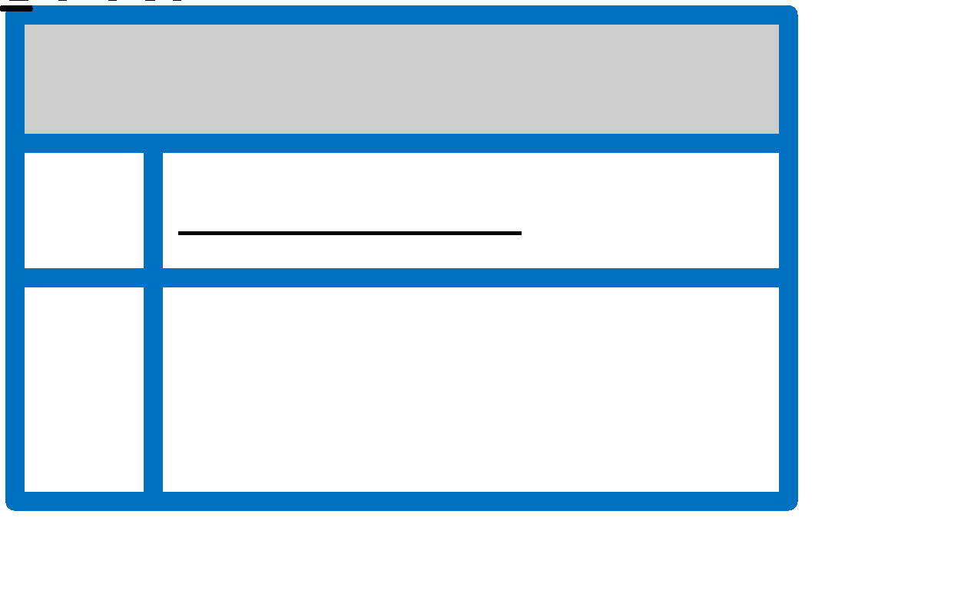
Dimensions
Number of Records:
1832
Number of Records:
7278
Number of Records:
1225
Number of Records:
36
Number of Records:
20
Type 1 Change
Type 2 Change

Slide 10
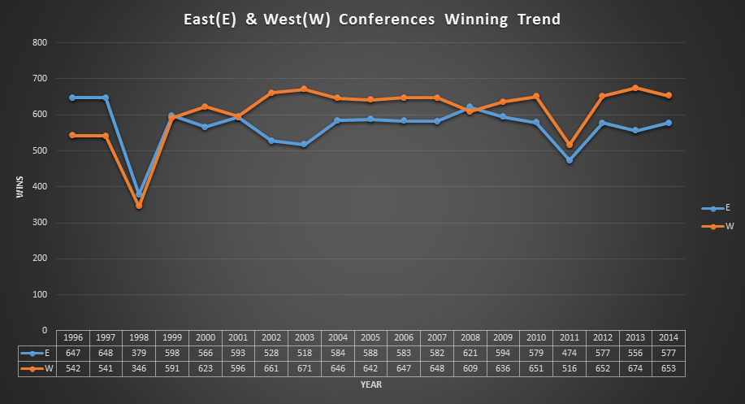
Team Historical Performances
By generating an OLAP cube, it was easy to see the trend of various statistics between conferences, divisions and teams over the past 20 seasons.

Slide 11
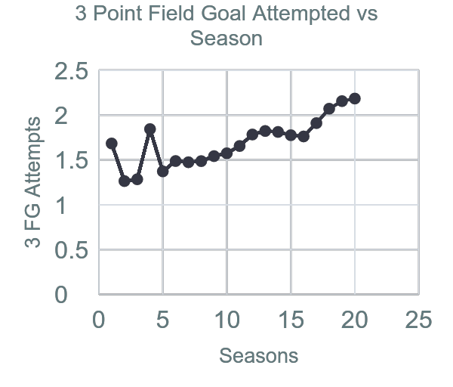
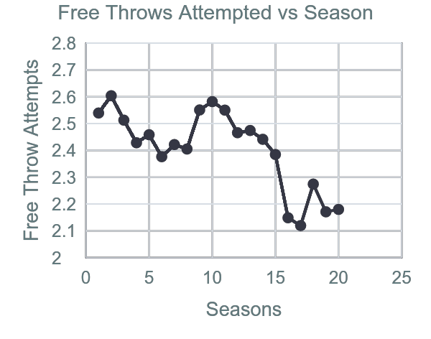
Average Player Performance
By looking at average of all players per season, the user can start looking at how an average player performs every season, and see the trends in the nba.
For example, here are graphs of 3 Point Field Goal Attempted and Free Throws Attempted vs. Season
While the 3 point field goal attempts are increasing, the free throw attempts are decreasing over the past 20 seasons.

Slide 12
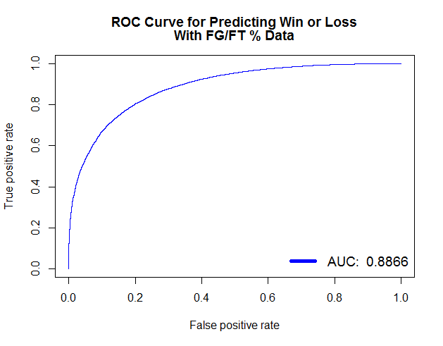
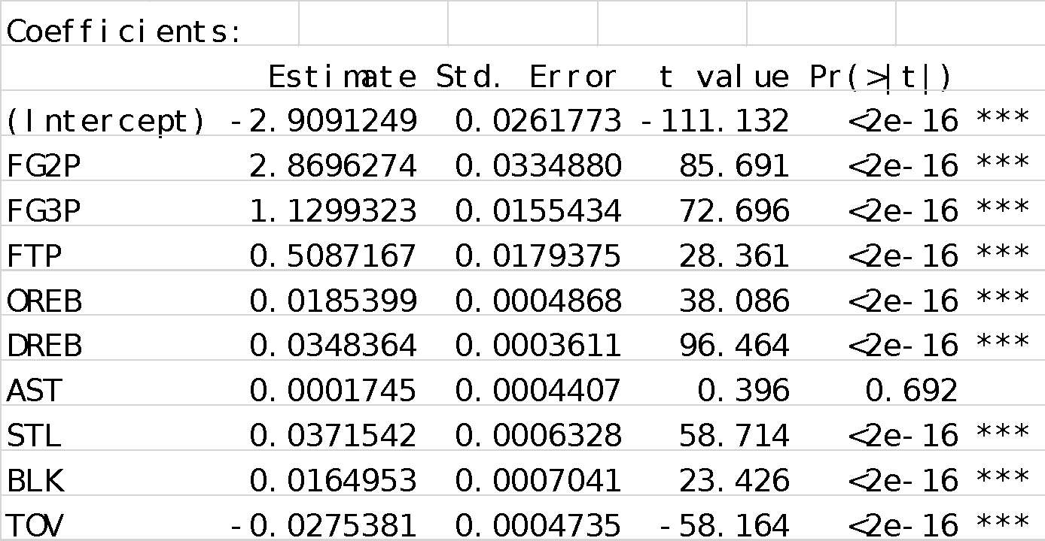
Team Win Predictor based on Statistics
By aggregating a team’s statistics for each game, a binary classifier can be built to predict a win or loss of a single game.
Notes:
The predictor is extremely good at distinguishing between a team that wins vs team that loses, based on their statistics.
The field goal percentage of the team is obviously a strong indicator of the team winning the game, and can be shown with the high t-value.
In order to further dive into the predictive model, the field goal percentages and free throw percentages were taken out for the next model.

Slide 13
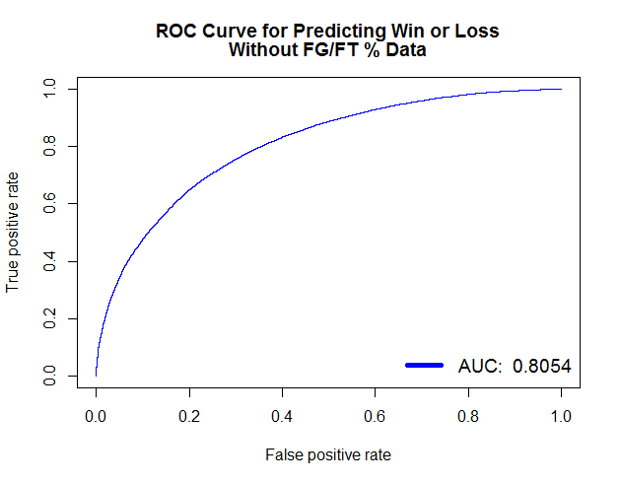
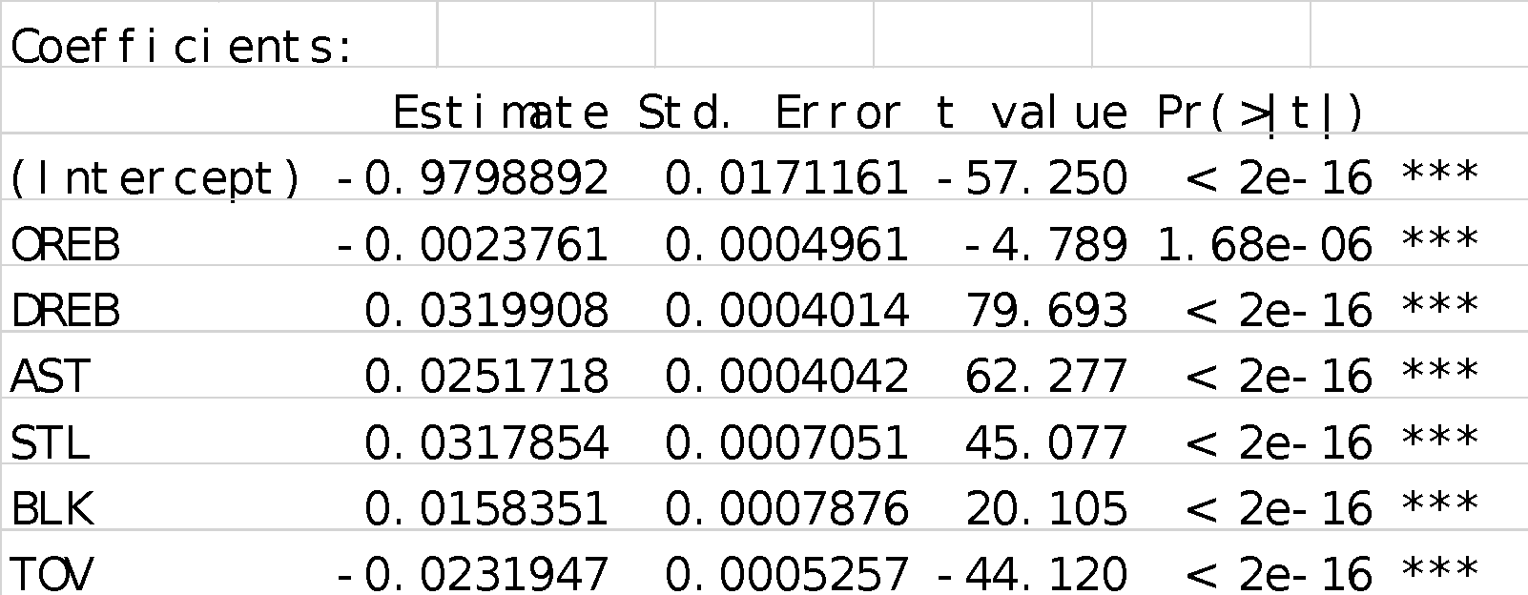
Team Win Predictor Results
In order to fully dive into the other statistics, % data was taken out to see the magnitude of importance between the other team statistics.
Notes:
Even without the percentage data, the model performs very well with an AUC of .8054.
Interestingly the # of offensive rebounds seem to be negatively correlated, while the defensive rebounds seem to be positively correlated.

Slide 14
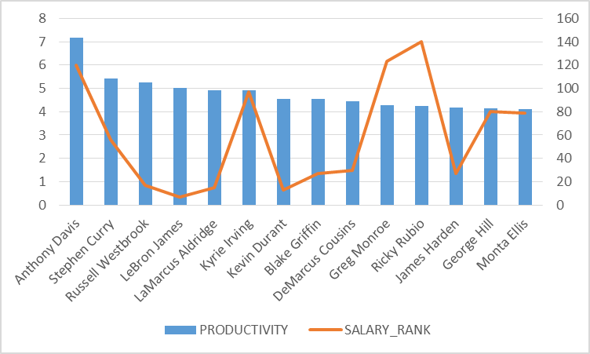

Player Performance Rating
Notes:
In order to show what is possible, we built a rudimentary formula on measuring a player’s performance, taking salary into consideration. If we were to build a formula based on PER, a complex formula from ESPN, and the win predictor results, we can build a even better performance metric.

Slide 15
Shooting Composition Analysis
For each player, just tracking their overall number of field goals can be misinterpreted very easily. In order to further dive into analyzing a player, one way is analyze the type of shots they take.
Drive: A drive represents any touch that starts at least 20 feet of the hoop, and is dribbled within 10 feet of the hoop, excluding fast breaks.
Catch & Shoot: A catch & shoot represents any jump shot outside of 10 feet where a player possessed the ball for 2 seconds or less and took no dribbles.
Pull Up: A pull up represents any jump shot outside 10 feet where a player took 1 or more dribbles before shooting.

Slide 16
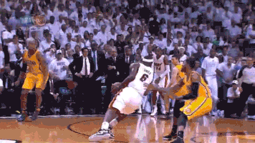
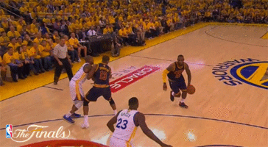
Shot Types: Drive
Drive:
A drive represents any touch that starts at least 20 feet of the hoop, and is dribbled within 10 feet of the hoop, excluding fast breaks.

Slide 17
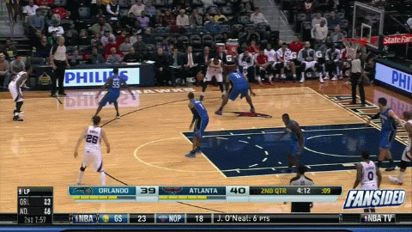
Shot Types: Catch & Shoot
Catch & Shoot:
A catch & shoot represents any jump shot outside of 10 feet where a player possessed the ball for 2 seconds or less and took no dribbles.

Slide 18

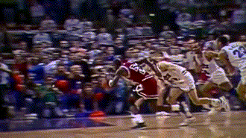
Shot Types: Pull Up and Others
Pull Up:
A pull up represents any jump shot outside 10 feet where a player took 1 or more dribbles before shooting.
Other:
Other types of shots that are not tracked by the SportVU camera tracking data.

Slide 19
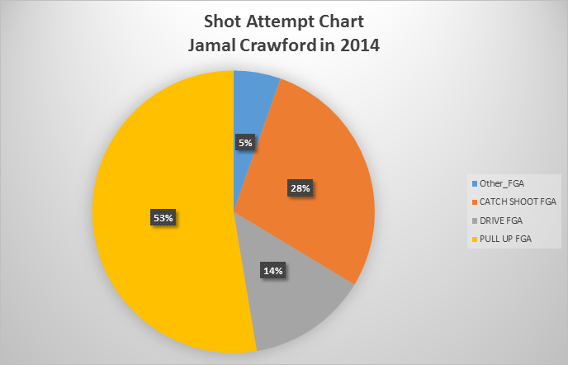
Shooting Composition Analysis
Orange: Catch & Shoot
Yellow: Pull Up
Grey: Drive
Blue: Others
Jamal Crawford is a typical pull up shooter.
Once he gets the ball, he has the green light to shoot most of the time, and does not pass the ball much.

Slide 20
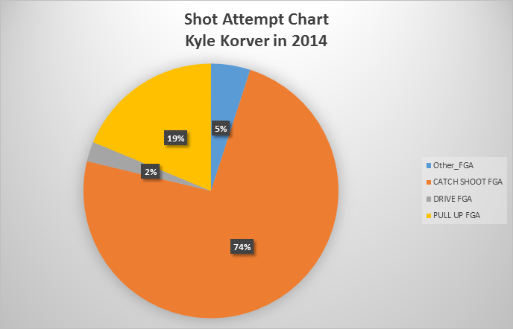
Shooting Composition Analysis
Orange: Catch & Shoot
Yellow: Pull Up
Grey: Drive
Blue: Others
Kyle Korver is a typical spot up shooter.
He doesn’t possess the ball much, and relies on others to get him the ball in the right spots.

Slide 21
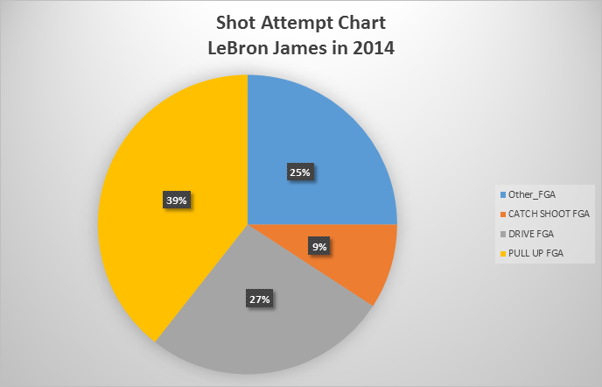
Shooting Composition Analysis
Orange: Catch & Shoot
Yellow: Pull Up
Grey: Drive
Blue: Others
LeBron James is a typical all around player.
He possesses the ball most of the game, and does not have a lot of catch and shoot attempts.

Slide 22
Let’s Roll(up)! ☺ OLAP Demonstration

Slide 23
Questions?

